Slide 1
What is overridden when linking local portfolios to the Community Zone
Yoel Kortick
Senior Librarian

Slide 2

Introduction
An example
Linking to the Community Zone
Results after linking to the Community Zone
Agenda

Slide 3
Introduction

Slide 4
Introduction
The Question:
When local portfolios are linked to the Community Zone as described at Linking a Local Electronic Collection to the Community Zone there is a confirmation message which includes “The local portfolios information may be overridden”.
What is overridden? For example, are the following overridden?
  Internal notes
  General notes
  POL
  Coverage and Library

Slide 5
Introduction
The Answer:
The “Library” of the portfolio is not removed
The local coverage remains, and global coverage is added.
All acquisition POLs remain.
All notes remain.
The parts of the portfolio which change can be seen in the history tab changed by “System”.

Slide 6
An example

Slide 7
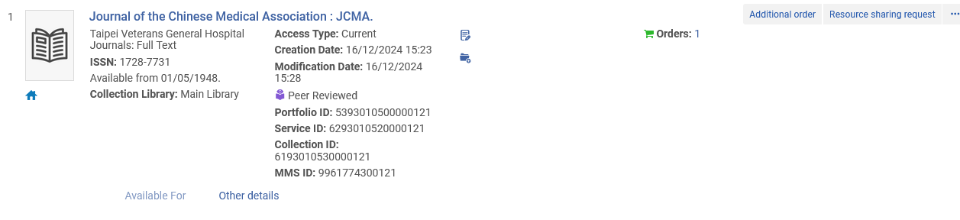
An example
“Journal of the Chinese Medical Association : JCMA” is a local portfolio in the local Electronic Collection “Taipei Veterans General Hospital Journals”.
A local portfolio (not linked to the Community Zone)

Slide 8
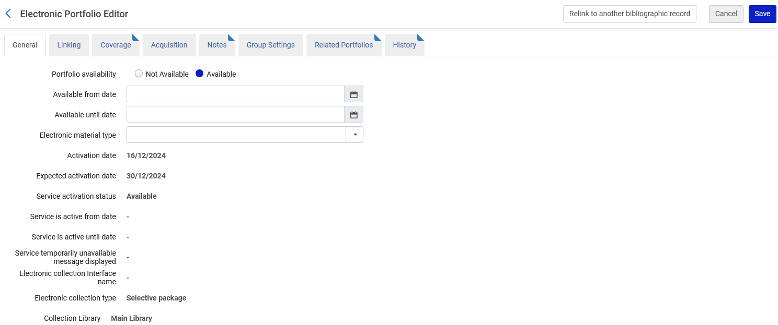
An example
Local portfolio “Journal of the Chinese Medical Association : JCMA” has a library (which in this case is inherited from the local Electronic Collection)

Slide 9
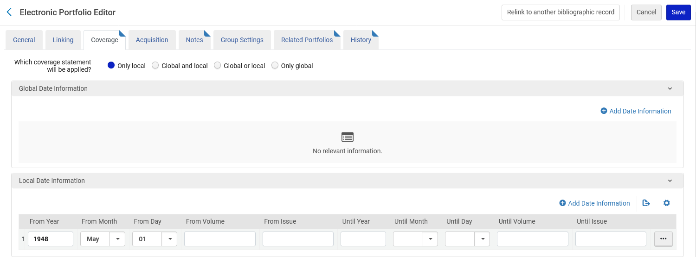
An example
Local portfolio “Journal of the Chinese Medical Association : JCMA” has local coverage

Slide 10
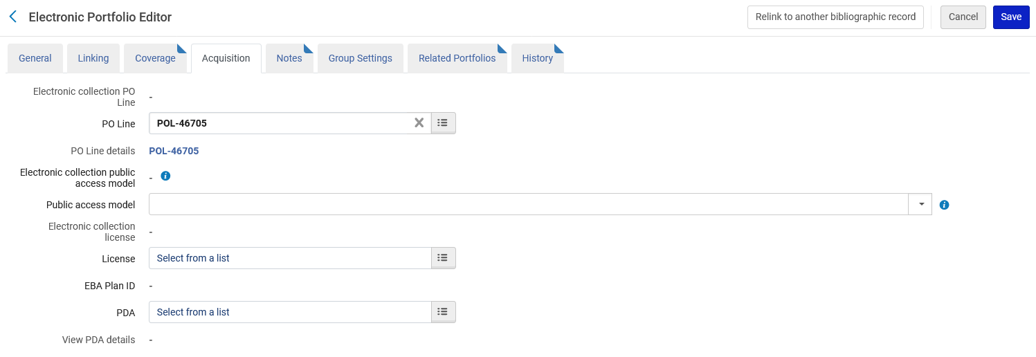
An example
Local portfolio “Journal of the Chinese Medical Association : JCMA” has a POL

Slide 11
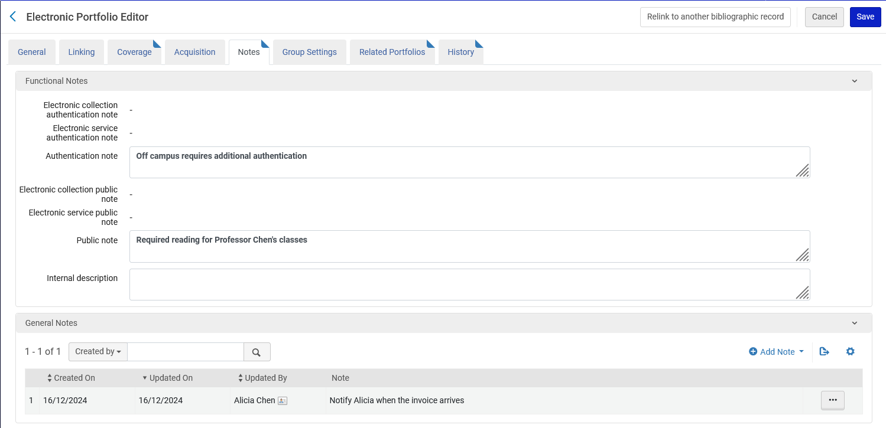
An example
Local portfolio “Journal of the Chinese Medical Association : JCMA” has both functional and general notes.

Slide 12
Linking to the Community Zone

Slide 13
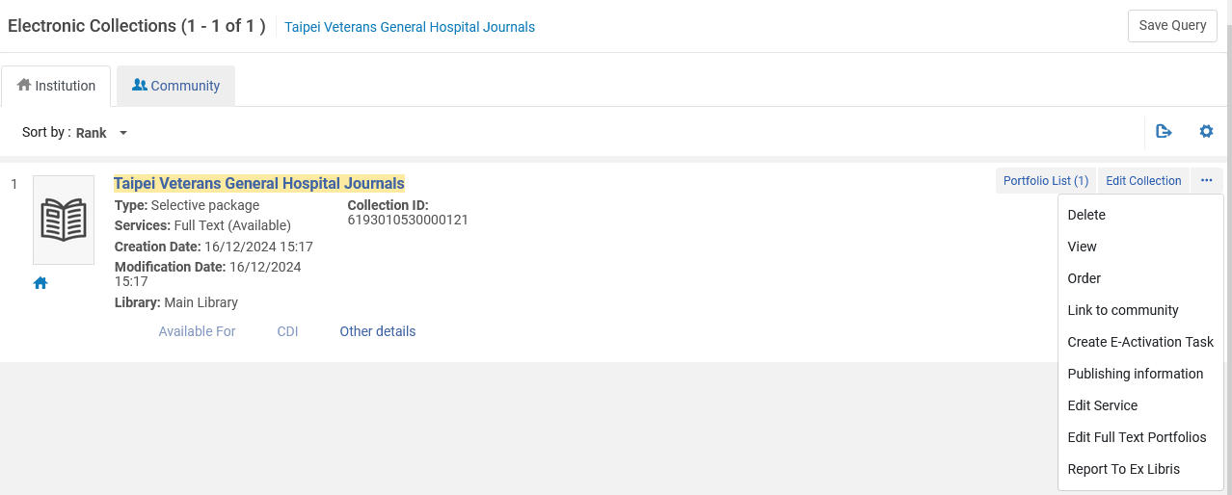
Linking to the Community Zone
We will now link the local Electronic Collection “Taipei Veterans General Hospital Journals” (which has local portfolio “Journal of the Chinese Medical Association : JCMA” to the Community Zone.
Icon signifying that the portfolio is not linked to the Community Zone (it is a local portfolio)

Slide 14
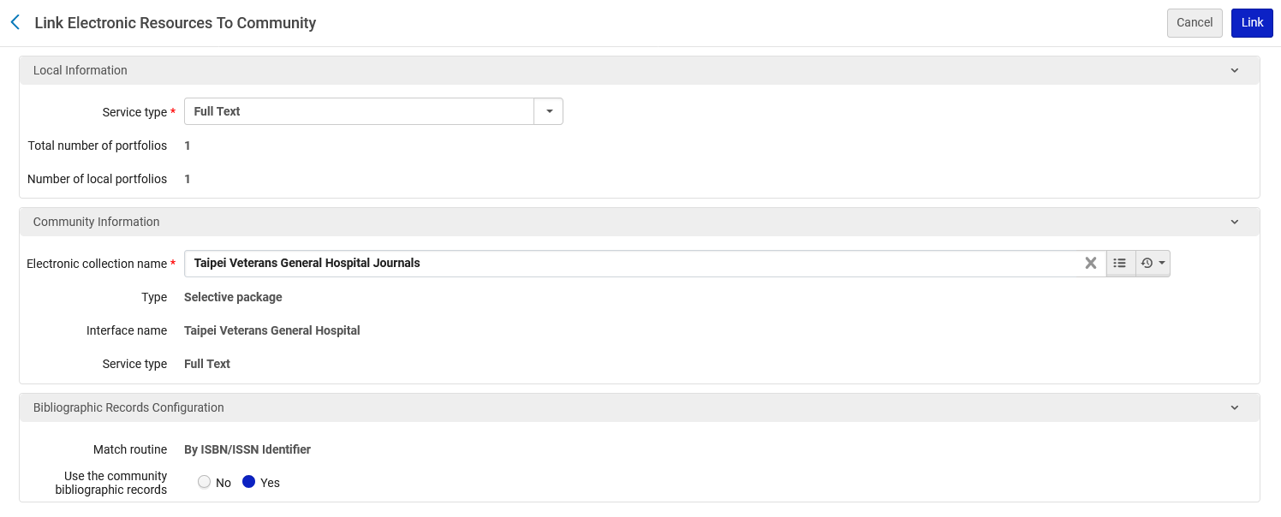
Linking to the Community Zone
The link will be made
A match will be attempted based on ISBN / ISSN

Slide 15
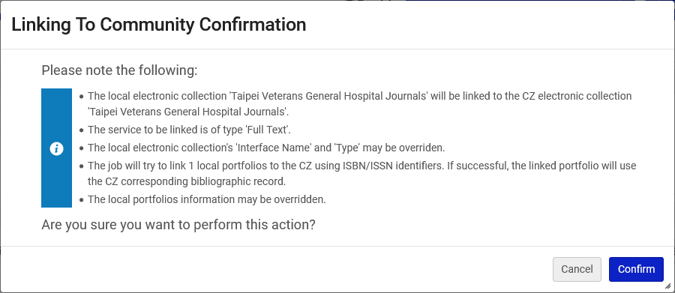
Linking to the Community Zone
There is a confirmation message which includes “The local portfolios information may be overridden”.

Slide 16
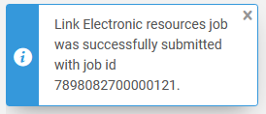
Linking to the Community Zone
A job is submitted to link the resources to the Community Zone

Slide 17
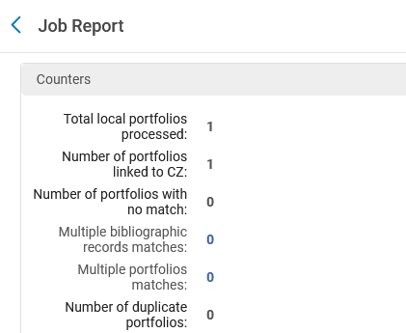
Linking to the Community Zone
According to the job report one portfolio was linked to the Community Zone (our sample Electronic Collection had only one portfolio)

Slide 18
Results after linking to the Community Zone

Slide 19
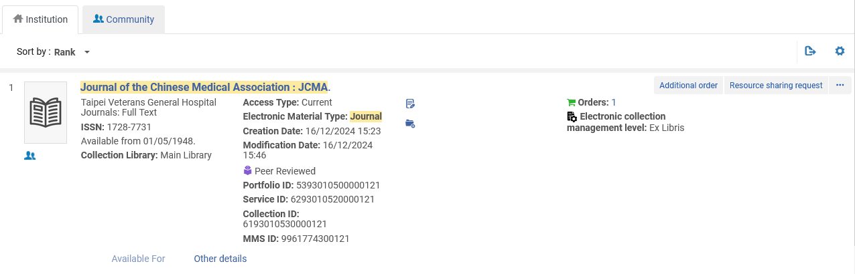
Results after linking to the Community Zone
The portfolio “Journal of the Chinese Medical Association : JCMA” in Electronic Collection “Taipei Veterans General Hospital Journals” is now linked to the Community Zone.
Icon signifying that the portfolio is linked to the Community Zone (it is not a local portfolio)

Slide 20
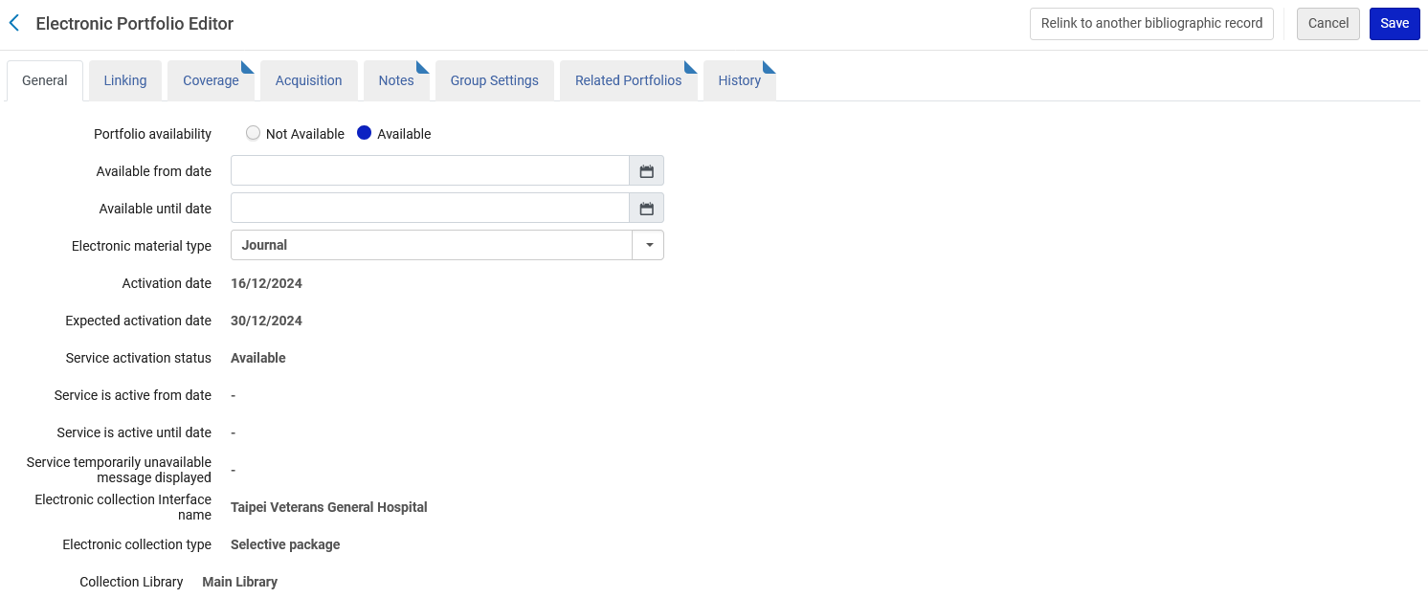
Results after linking to the Community Zone
The portfolio library still exists

Slide 21
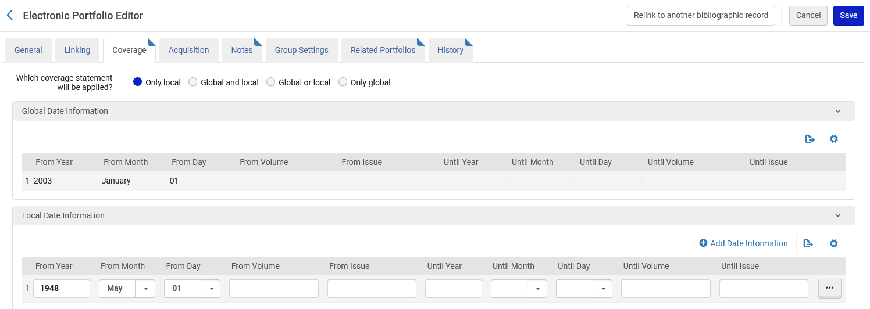
Results after linking to the Community Zone
The portfolio local coverage still exists (and global coverage has been added)

Slide 22
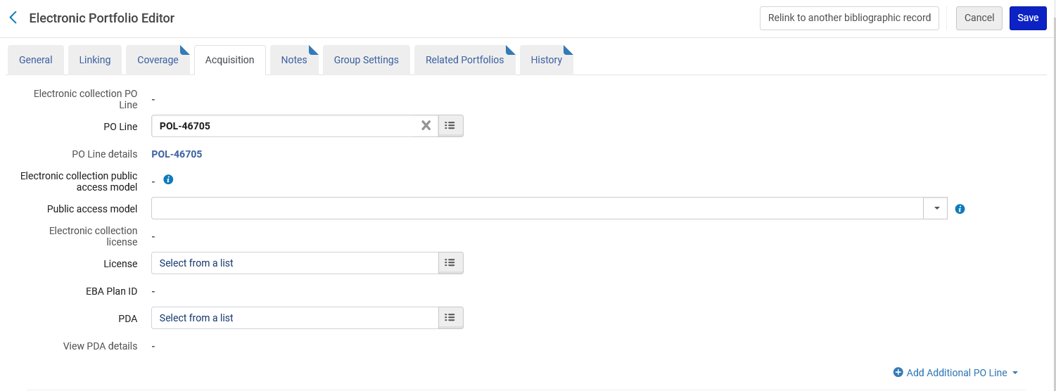
Results after linking to the Community Zone
The portfolio POL still exists

Slide 23
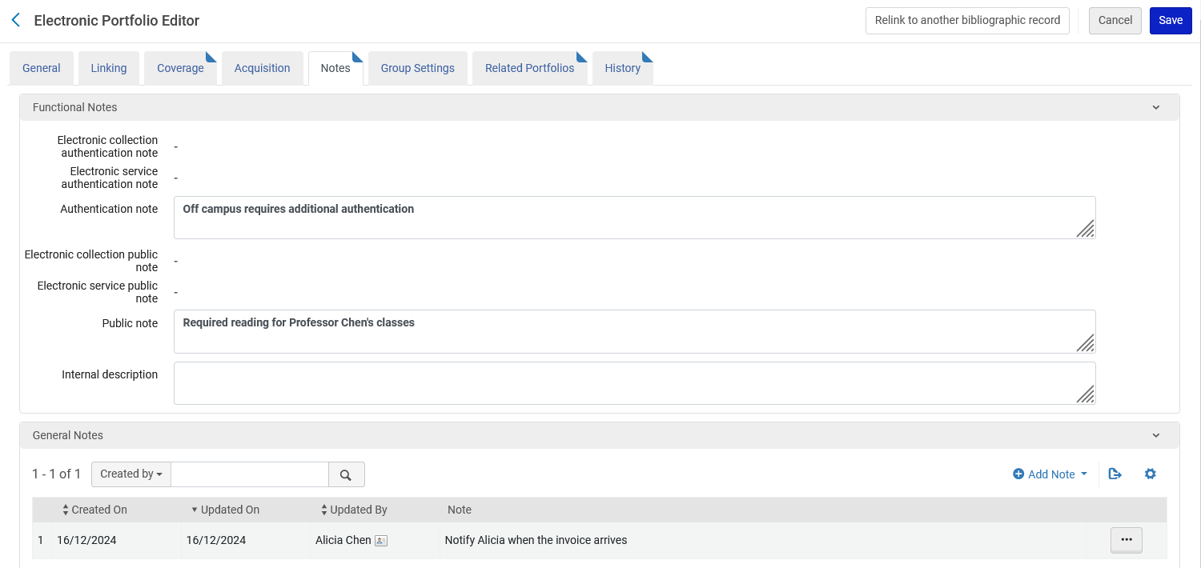
Results after linking to the Community Zone
The portfolio functional and general notes still exist

Slide 24
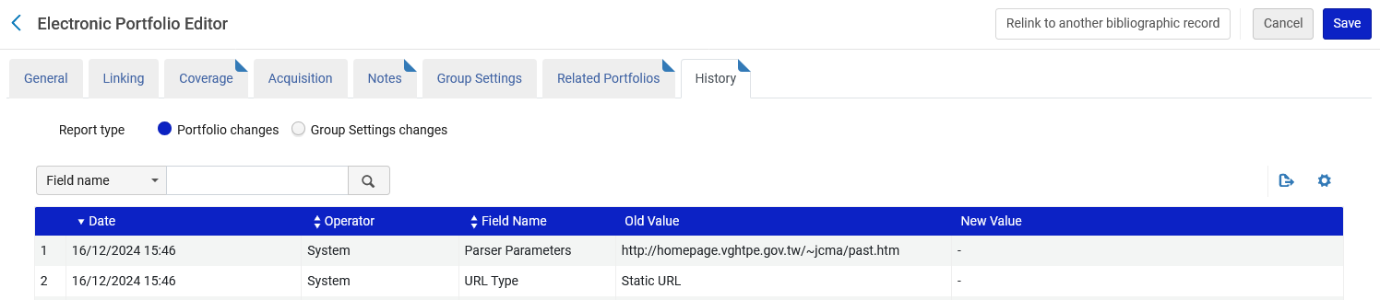
Results after linking to the Community Zone
The parts of the portfolio which change can be seen in the history tab changed by “System”.

Slide 25
xxx@exlibrisgroup.com

